Slide 1

Offline Handwritten Yoruba character recognition using convolutional neural networks
By Samuel Ojumah (10CG011029)
A Project Proposal

Slide 2
Outline
Introduction
Literature Review
Related Works
Statement of the Problem
Aim and Objectives
Methodology
Significance of the Study
Expected Contribution to Knowledge
Conclusion
References
Acknowledgement

Slide 3
Introduction
Deep learning is one of the foremost trends in computing today that has led to state-of-the-art results in image recognition, speech recognition and natural language processing.
By developing deep architectures, neural networks have been able to out-perform other algorithms in recognizing and classifying objects in images.
Character recognition is one of the many domains of image recognition.

Slide 4
Introduction cont
Two types of character recognition systems : Online and Offline recognition (Ajao et al., 2014)
Online: recognizes character patterns captured from a pen-based or touch-based input device
Offline: recognizes character patterns captured from a scanner or a camera device as two dimensional images

Slide 5

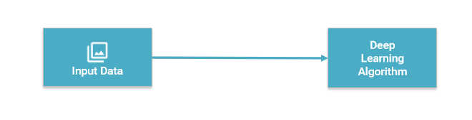
Introduction cont
Deep learning architecture
Figure 1: Traditional machine-learning architecture and deep learning architecture
Source: http://www.slideshare.net/LuMa921/deep-learning-the-past-present-and-future-of-artificial-intelligence

Slide 6
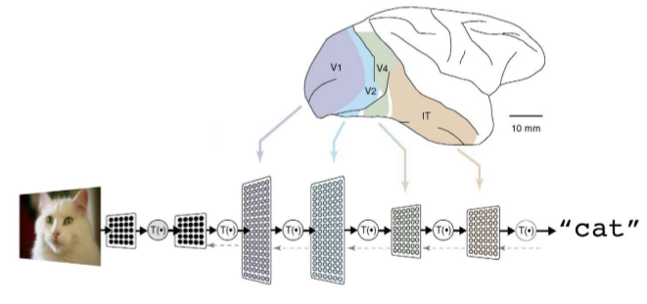
Deep Learning - Architecture
A deep neural network consists of a hierarchy of layers, whereby each layer transforms the input data into more abstract representations (e.g. edge -> nose -> face). The output layer combines those features to make predictions
Figure 2: A deep neural network architecture for recognizing a cat photo
Source: https://cloud.google.com/blog/big-data/2016/07/understanding-neural-networks-with-tensorflow-playground

Slide 7
Literature Review

Slide 8
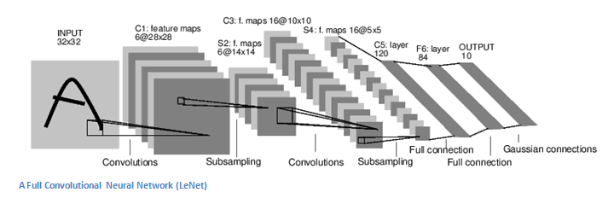
Convolutional neural networks
A Convolutional Neural Network (ConvNet) consists of several layers which can be of three types: convolutional, pooling and full-connected layers.
Figure 3: A convolutional neural network architecture (LeNet)
Source: https://culurciello.github.io/tech/2016/06/04/nets.html

Slide 9
Literature Review cont
AlexNet (2012)
Trained the network on ImageNet data, which contained over 15 million annotated images from a total of over 22,000 categories.
Used Rectified Linear Unit (ReLU) for the nonlinearity functions (Found to decrease training time as ReLUs are several times faster than the conventional tanh function).
Trained on two GTX 580 GPUs for five to six days.

Slide 10
Literature Review cont
ZF Net(2013)
Very similar architecture to AlexNet, except for a few minor modifications. AlexNet trained on 15 million images, while ZF Net trained on only 1.3 million images.
Instead of using 11x11 sized filters in the first layer (which is what AlexNet implemented), ZF Net used filters of size 7x7 and a decreased stride value.
Used ReLUs for their activation functions, cross-entropy loss for the error function, and trained using batch stochastic gradient descent.
Trained on a GTX 580 GPU for twelve days.

Slide 11
Literature Review cont
GoogLenet (2015)
Used 9 Inception modules in the whole architecture, with over 100 layers in total!
No use of fully connected layers! They use an average pool instead, to go from a 7x7x1024 volume to a 1x1x1024 volume. This saves a huge number of parameters.
Uses 12x fewer parameters than AlexNet.
Trained on a few high-end GPUs within a week.

Slide 12
Literature Review cont
Microsoft ResNet (2015)
52 layers
Trained on an 8 GPU machine for two to three weeks.
3.6% error rate
The ResNet model is the best CNN architecture that we currently have and is a great innovation for the idea of residual learning.

Slide 13
Literature Review cont
(Raina et al., 2014) suggested that GPU’s could operate at speeds up to 70 times faster than the CPU counterparts and increasingly realized that making use of lots of training data and of fast computation had been greatly undervalued in favor of incremental changes in learning algorithms.

Slide 14
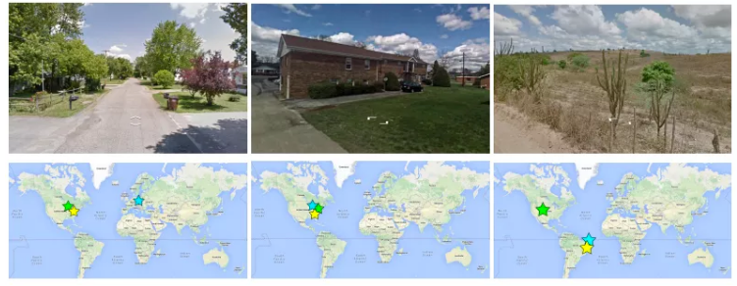
Literature Review cont
(Weyand et al., 2016) introduced PlaNet which takes a Photo and gives the exact location on the earth.
Figure 4: Images from PlaNet with exact locations of places on earth.
Source: Weyand et al. (2016)

Slide 15


Deep Learning frameworks
Caffe - (Jia et al., 2014)
MatConvNet - (Vedaldi and K. Lenc, 2015)
Theano – (Al-Rfou et al., 2016)
Tensorflow- (Abadi et al., 2016)

Slide 16
Related Works

Slide 17
Related Works cont
(Patil & Shimpi, 2011) in Handwritten English character recognition using neural networks
Used neural networks with back-propagation for English characters
Achieved recognition rates of 70%
(Lui et al., 2013) in Online and offline handwritten Chinese character recognition: Benchmarking on new databases
Achieved recognition rates of 94.85% with less samples.

Slide 18
Related Works cont
(Oyedotun & Olaniyi, 2015) : Deep Learning in Character Recognition Considering Pattern Invariance Constraints
Used only Yoruba vowels for experiments.
(Ajao et al., 2016) in Hidden Markov Model Approach for Oﬄine Yoruba Handwritten Word Recognition used HMM’s for Yoruba characters.
Achieved recognition rates of 95.6%
Data was limited to Yoruba medical pathology words.

Slide 19
Related Works cont
(Zhang et al., 2017) in Online and offline handwritten Chinese character recognition: A comprehensive study and new benchmark integrated traditional normalization-cooperated direction-decomposed feature map (directMap) with the deep convolutional neural network (convNet).
Achieved the best recognition rates of HCCR.

Slide 20
Statement of the problem
Extracting textual information from natural images is a challenging problem with many practical applications (Wang et al., 2012)
CNN’s have been applied to OCR systems for English, Chinese, French and other languages but has not been applied to Yoruba characters.

Slide 21
Aim
To develop a neural network model capable of identifying yoruba characters from an image.

Slide 22
Objectives
Create a dataset of yoruba characters.
Define a network architecture for the model.
Train the neural network with the dataset.
Evaluate the network’s accuracy with test samples in the dataset.

Slide 23
Methodology

Slide 24
Methodology (Objective A: Create a dataset of unique Yoruba characters)
We will create a publicly available dataset which will contain alphabets of the Yoruba language and be divided in two sets: training and test sets.
Three-step process:
Design a form to collect handwritings from various sources.
Scan individual characters and place into train and test folders.
Create an online repository for the images.

Slide 25
Methodology (Objective B: Define a network architecture)
Use existing architectures: GoogLenet and Microsoft ResNet.

Slide 26
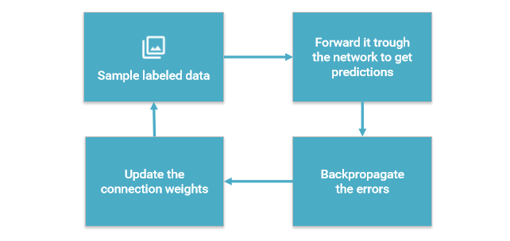
Methodology (Objective C: Train the neural network)
Learns by generating an error signal that measures the difference between the predictions of the network and the desired values and then using this error signal to change the weights (or parameters) so that predictions get more accurate.
Figure 5: Training in a Deep neural network
Source: http://www.slideshare.net/LuMa921/deep-learning-the-past-present-and-future-of-artificial-intelligence

Slide 27
Methodology (Objective D: Evaluate the network’s accuracy)
Use the test folders on the network to test the accuracy of recognition.

Slide 28
Materials Needed
Yoruba Handwritten dataset.
Deep learning frameworks: Caffe (Jia et al., 2014) and Nvidia DIGITS.
Graphics Processing Units (Nvidia) - *$187 (AWS Cloud Estimate)
Software programming language: Python

Slide 29
Significance of the study

Slide 30
Significance of study
By building this technology:
Opening up a new world for local technology.
Personalized experience for locals and better understanding of digital content.

Slide 31
Expected contribution to knowledge

Slide 32
Expected contribution to knowledge
Creation of a publicly available dataset for Yoruba handwritten characters.
Neural network model to identify handwritten Yoruba characters.

Slide 33
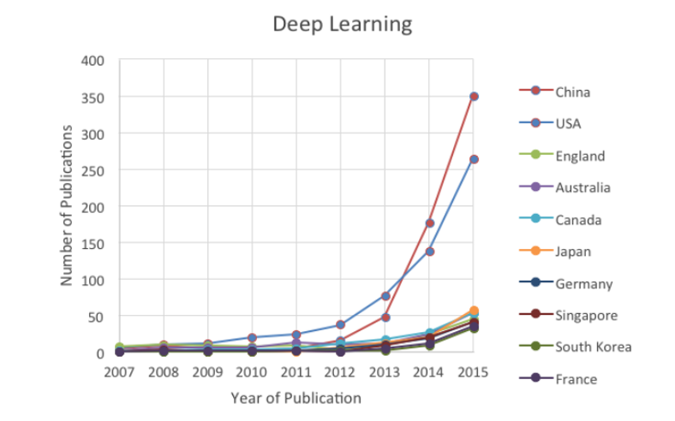
Figure 6: Trends for Machine learning and deep learning
Source: Bloomberg

Slide 34
Conclusion
This research will make use of convolutional neural networks to provide state-of-the-art results in Yoruba handwritten recognition.
We expect to deliver recognition rates of about 99%.

Slide 35
References
Abadi, M., Agarwal, A., Barham, P., Brevdo, E., Chen, Z., Citro, C., ... & Ghemawat, S. (2016). Tensorflow: Large-scale machine learning on heterogeneous distributed systems. arXiv preprint arXiv:1603.04467.
Ajao, J. F., Olabiyisi, S. O., Omidiora, E. O., & Odejobi, O. O. Yoruba Handwriting Word Recognition Quality Evaluation of Preprocessing Attributes using Information Theory Approach.
Jia, Y., Shelhamer, E., Donahue, J., Karayev, S., Long, J., Girshick, R., ... & Darrell, T. (2014, November). Caffe: Convolutional architecture for fast feature embedding. In Proceedings of the 22nd ACM international conference on Multimedia (pp. 675-678). ACM. Chicago
Liu, C. L., Yin, F., Wang, D. H., & Wang, Q. F. (2013). Online and offline handwritten Chinese character recognition: benchmarking on new databases. Pattern Recognition, 46(1), 155-162.
Oyedotun, O. K., Olaniyi, E. O., & Khashman, A. (2015). Deep learning in character recognition considering pattern invariance constraints. International Journal of Intelligent Systems and Applications, 7(7), 1.
Oyedotun, O. K., & Dimililer, K. (2016). Pattern recognition: invariance learning in convolutional auto encoder network. International Journal of Image, Graphics and Signal Processing, 8(3), 19

Slide 36
References
Patil, V., & Shimpi, S. (2011). Handwritten English character recognition using neural network. Elixir Comput Sci Eng, 41, 5587-5591.
Raina, R., Madhavan, A., & Ng, A. Y. (2009, June). Large-scale deep unsupervised learning using graphics processors. In Proceedings of the 26th annual international conference on machine learning (pp. 873-880). ACM.
Sermanet, P., Chintala, S., & LeCun, Y. (2012, November). Convolutional neural networks applied to house numbers digit classification. In Pattern Recognition (ICPR), 2012 21st International Conference on (pp. 3288-3291). IEEE..
Szegedy, C., Ioffe, S., Vanhoucke, V., & Alemi, A. (2016). Inception-v4, inception-resnet and the impact of residual connections on learning. arXiv preprint arXiv:1602.07261.
Weyand, T., Kostrikov, I., & Philbin, J. (2016). Planet-photo geolocation with convolutional neural networks. arXiv preprint arXiv:1602.05314.
Wang, T., Wu, D. J., Coates, A., & Ng, A. Y. (2012, November). End-to-end text recognition with convolutional neural networks. In Pattern Recognition (ICPR), 2012 21st International Conference on (pp. 3304-3308). IEEE.

Slide 37
Acknowledgments
I wish to express my sincere gratitude to God who by Inspiration gave me this topic.
I sincerely thank Professor Sanjay Misra for the guidance and encouragement in carrying out the research work as well as Mr Wole Adewunmi and Miss Olaperi Sowunmi for the helps.
I wish to express my gratitude to Dr. (Mrs) Oladipupo and the PG co-ordinator Dr Oyelade as well as the management of Covenant University for this platform to share ideas and push humanity forward.
And to my family, friends and everyone present here today.

